Slide 1
Mobility Management
Mobile node changes its physical location (address) at a much smaller timescale-
To ensure that a mobile node m is able to communicate with some other node n in a network, the networking infrastructure has to ensure that
(1) m’s location [e.g., its access point (AP) in wireless local area networks (WLANs) and base stations in cellular networks] can be determined so that a route can be established between m and n,
(2) when m moves out of the range of the current AP [henceforth, we use the two terms, access point and base station, interchangeably], it establishes a connection with another AP, and
(3) the connection/data packets are rerouted correctly to the new AP.

Slide 2
Mobility Management cont…
Maintaining the current location of every mobile node in the network, is known as location management.
Conceptually, any location management scheme consists of two operations: search and update.
The search operation is invoked by a node that wants to establish a connection with a mobile node whose location it currently does not know.
The update operation, also known as a registration operation, is performed to inform the system of the mobile node’s current location.

Slide 3
Mobility Management cont…
Location information can be maintained at various granularities. In a cellular system, for example, the finest granularity at which location can be (and needs to be) maintained is a cell.
This would require a mobile node to update its location whenever it moves from one cell to another.
However, if the location information is maintained at a coarser granularity, say, in an area consisting of certain number of contiguous cells, then the search cost increases because a larger number of cells need to be paged to obtain the exact location (cell) of the mobile node each time a call needs to be established.
Thus the granularity of location information maintained for a mobile node by the system has an impact on the performance of the location management scheme.
Another important aspect is the organization of the location registrars, databases that store the location information of the mobile nodes.

Slide 4
Mobility Management cont…
Another important mobility management task, which is known as handoff, is concerned with ensuring that the mobile node remains connected to the network while moving from one cell to another.
This is especially important when a mobile node has several active connections that have in-transit packets.
Handoff conceptually involves several subtasks:
(1) deciding when to hand off to a new AP,
(2) selecting a new AP from among several APs in the vicinity of the mobile node,
(3) acquiring resources such as channels,
(4) informing the old AP so that it can reroute the packets it gets for this mobile node and also transfer any state information to the new AP.

Slide 5
Mobility Management cont…
The decision to initiate a handoff [which can be taken either by the mobile node, i.e., mobile-controlled handoff (MCHO), or by the AP, i.e., network-controlled handoff (NCHO)] may depend on several factors such as
1) the quality of the wireless communication between the mobile node and the AP [as indicated by the signal-to-noise ratio (SNR)] and
2) the load on the current AP (if the current base station is running out of communication channels, it may want to switch a mobile node to a neighboring lightly loaded AP).
The choice of the base station to which to hand off may depend on such factors as
(1) the SNR of the beacon signals from these APs,
(2) the region the mobile node is expected to move to in the near future, and
(3) the availability of resources at the AP.

Slide 6
Mobility Management cont…
Mobility management consists of: location management and handoff management
In the case of mobile telephony, location management is needed to ensure that the mobile node can be located quickly when a new call arrives so that a connection can be established.
A call to a mobile node is dropped if the mobile node cannot be reached within a certain time.
  Location management plays a crucial role in minimizing the number of calls that are dropped.
Handoff management is needed to ensure that ongoing calls continue with minimal degradation in quality of service (QoS) irrespective of the mobility of the endpoints (caller/callee) of the connection.
For packet communication, location management is needed to inform the sender of the new address of the mobile node so that future packets can be addressed to the current address of the mobile node.
Handoff management ensures that the mobile node always remains reachable to receive (or send) any packets and to forward the packets from the old address to the new address.

Slide 7
Location Management Principles and Techniques
Location Area
  A set of base stations (10s or even 100s)
  Grouped for optimized signaling
  A unique Location Area Code is assigned
  Also called registration area
Location Update Procedure
  A mobile device is switched on
  A mobile device inform a cellular network whenever it moves from one location area to another
  Mobiles are responsible for detecting location area code
Roaming
  A Mobility management procedure of all cellular networks

Slide 8
Location Management Principles and Techniques
TMSI (Temporary Mobile Subscriber Identity)
  Given to the mobile, the moment it is switched on
  Local to location area
  Has to be updated, each time the mobile moves to a new geographical area
IMSI (International Mobile Subscriber Identify)
  A unique number associated with GSM and UMTS network mobile phone users
  The number is stored in SIM (Subscriber Identity Module) card

Slide 9


Location Management Principles and Techniques
Location Management Principles & techniques
  Location Registrars (databases)
  Location Area
  Search Operation
  Update operation
    Static Update Schemes
    Dynamic Update Schemes

Slide 10
Location Management Principles and Techniques
Search and Update Operations
  Uses a single-location registrar to maintain the location information of all the mobile nodes.
  home location registrar (HLR)
  The location of a mobile node is maintained at the granularity of a cell
  Mobility (m,c)
    C – latest cell of mobile node m known to the HLR

Slide 11
Location Management Principles and Techniques
Location management schemes use several databases called location registrars to maintain the location and other information, such as preferences and service profile, of mobile nodes.
To understand why more than one location registrar may be helpful, let us consider a simple location management scheme that uses a single-location registrar, called the home location registrar (HLR), to maintain the location information of all the mobile nodes in the network.
In this simple location management scheme, the search and update operations are performed as follows:
The location of a mobile node is maintained at the granularity of a cell, i.e., which cell the mobile node was in when it last registered. For each mobile node m, the HLR maintains a mobility binding (m, c), where c is the latest cell (location) of m known to the HLR. The location information of m in the HLR is updated as follows:

Slide 12
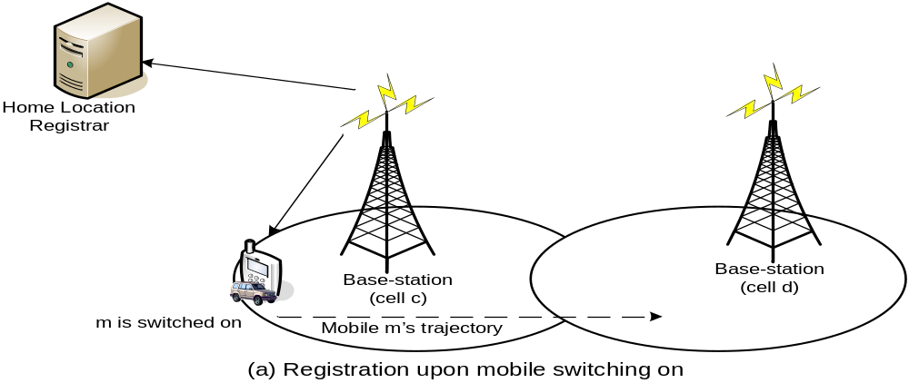
Simple Location Management Scheme (cont.)
Search and Update Operations (mobile node m is switched on) – Static Update –
When a mobile node is switched on, the HLR is notified of the current location of m (the cell in which the mobile node is located). As illustrated in Fig. 2.1a, the mobile node m’s location is sent to the location server. The registration message travels via the base station of the cell to the location server.

Slide 13
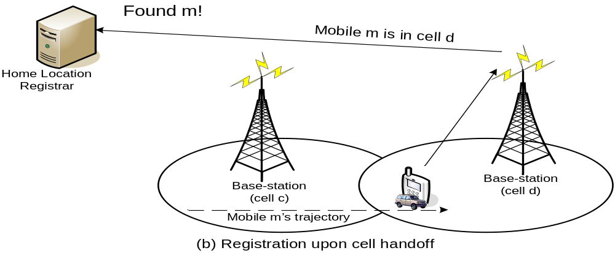
Simple Location Management Scheme (cont.)
Search and Update Operations (mobile node moves from cell c to cell d) - Whenever handoff occurs, the HLR is notified of the cell ID to which m is handing off to. As illustrated in Fig. 2.1b, when the mobile node moves to cell d from cell c, the mobile node may decide to register its location to be cell d.

Slide 14
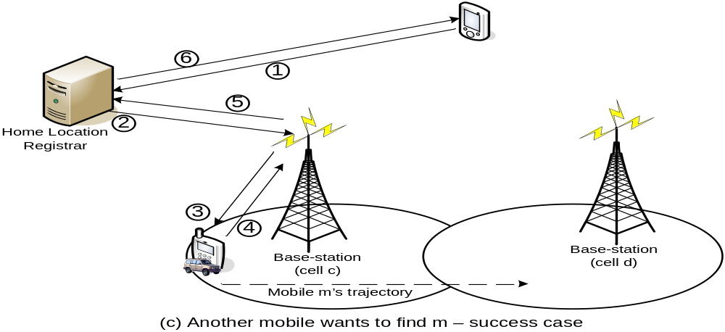
Search and Update Operations (m in cell c & ON)
To find a mobile node m’s current location, first the HLR is contacted. The HLR contacts the base station of cell c in the mobility binding for m. The base station pages for mobile m in its cell. If m is in cell c and is switched on, then it can respond to the page message, and connection can be established. Figure 2.1c illustrates the messaging between various entities in this location management scheme.

Slide 15
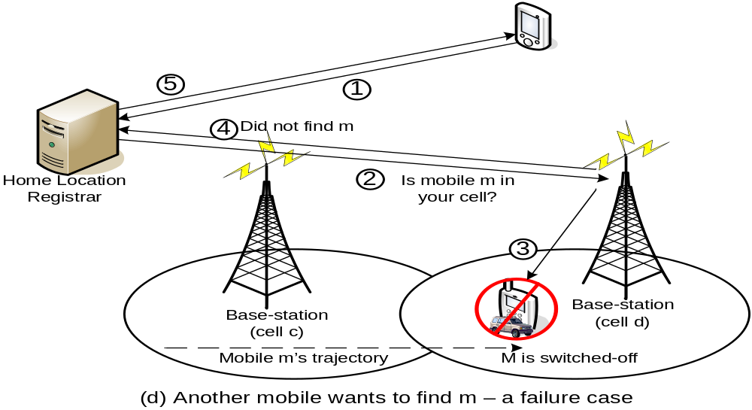
Simple Location Management Scheme (cont.)
Search and Update Operations (find m location; m is OFF)

Slide 16
Fig. 2.1d
Obviously, if the mobile node is not switched on, the call cannot be established (Fig. 2.1d)].
Another scenario in which the system may be unable to establish a call is when the location information provided by the HLR is not the most recent location information for mobile node m.
This can happen if m handed off to another cell between the time its location information was obtained from the HLR and cell c paged for it. For example, this would be the case if in the scenario illustrated in Fig. 2.1 mobile node m hands off to cell d just after the mobile node attempting to contact it obtains its location information.
As the average time a mobile node stays in a cell before moving to another cell, called the cell residency time, decreases, this situation can occur with increasing frequency.
In general, the average cell residency time depends on the cell size and the mobility pattern of the mobile node.

Slide 17


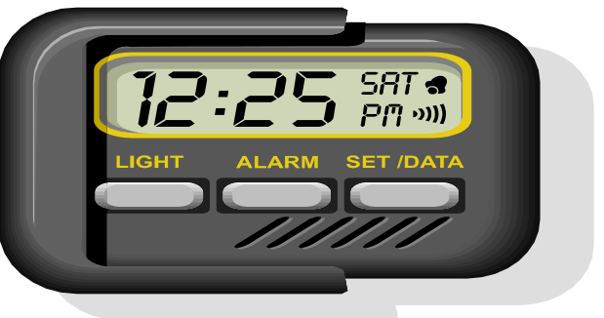
Mobility Binding of a Mobile Node
How to reduce the probability of failure (1 – max, 0 – min)?
Enhancement 1 – reduce search cost through the # of updates performed at HLR per mobile node
binding(m,c, tu, ttl)
  tU – the time when the binding was last updated
  ttL – the time to live (how long the binding is valid)
  tP – periodically update time < ttL

Slide 18
Mobility Binding of a Mobile Node (cont.)
How to reduce the probability of failure (1 – max, 0 – min)?
Enhancement 2 – page neighbor cells
  Increasing areas/cells for a maximum of k rings
  If the speed of mobile node m is a maximum of vm cells per second, then k can be set to
  k = vm x tp

Slide 19
Registration Area-based Location Management
Used by Personal Communication Service (PCS) - GSM
Service areas of PCs – the set of all cells (the union of coverage area of all the cells)
  Partitioned into several Registration Areas (RAs) or Location Areas
  Each RA consists of several contiguous communication cells

Slide 20
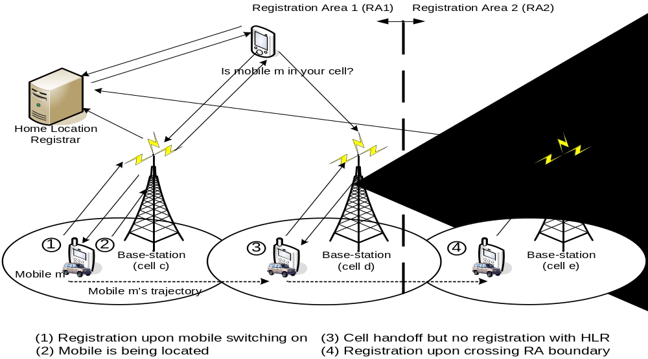
Registration Area-based Location Management (cont.)

Slide 21
Registration Area-based Location Management (cont.)
Cell c & d – in RA1
Cell e – in RA2
Node m moves from cell c to d
  Average update cost is reduced, because the HLR is not informed when handoff involves cells belonging to same RAs
  Search cost is increased, because all the cells in the RA have to be contacted for the exact location of the mobile node

Slide 22
Registration Area-based Location Management (cont.)
2-Level Hierarchy of Location Registrars
  Local Location Registrars
  Remote Location Registrars
Used in GSM to avoid contacting all the cells in the RA to locate a mobile node
  One Location Registrar ↔ 1 RA
  One Location Registrar ↔ several RAs (in practice)
  N Registration Areas (RA1, RA2, …, RAn)
  N Local Location Registrars (LR1, LR2, …, LRn)
  LRi is the Local Location Registrars of RAi
  All others location registrars as Remote Location Registrars
Accessing a local location registrar is less expensive than accessing a remote location registrar

Slide 23
Location Management
Home Location Registrars
Visitor Location Registers
Forwarding Pointers
Per-user Caching

Slide 24
Actual Address vs. Forwarding Pointer
Alice in & moves quite often (every week) – Texas: Dallas → El Paso → Austin → Houston
  Maintaining a forwarding location pointer: reduce the burden of Local Updating cost for Alice
Bob
  Increasing the Remote Search Cost
  Contact NY Registrar first, then contact Texas Registrar
Which Method is better?
  Actual Address at Home Location Registrar
  Forwarding Pointer (Location pointer)
  Depends on whether Alice moves more often than she is being contacted by some other person.

Slide 25
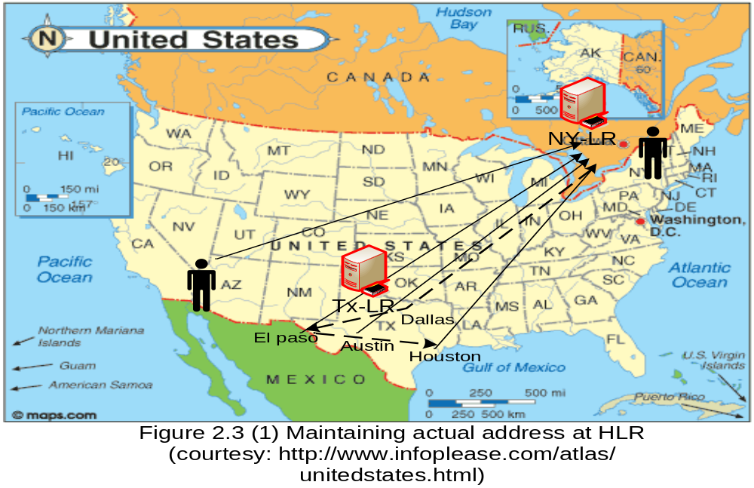
Actual Address vs. Forwarding Pointer (cont.)
Alice:
If Never
Change
address in TX
*Maintain the
Actual addr at
Home LR: NY
Is better!
Bob:
→ NY LR

Slide 26
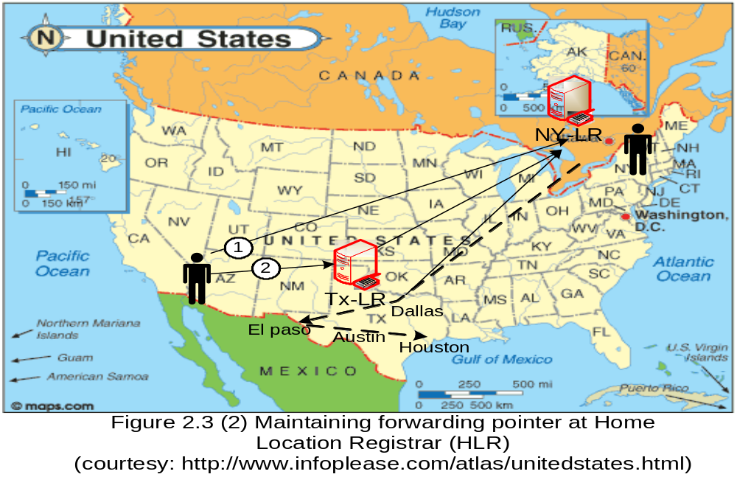
Actual Address vs. Forwarding Pointer (cont.)
Alice moves often: Dallas, El Paso, Austin, Houston
* Maintain a location pointer at NY
Bob: contact
Tx-LR for subsequent loc. info

Slide 27
A Chain of Forwarding Pointers
Alice
  Maintaining Forwarding Pointers of length 3
  New York → Texas → Alaska → Alabama
Bob
  Trying to locate Alice
  Start with New York registrar then follow the forwarding pointers
  For 4 location registrars New York → Texas → Alaska → Alabama

Slide 28
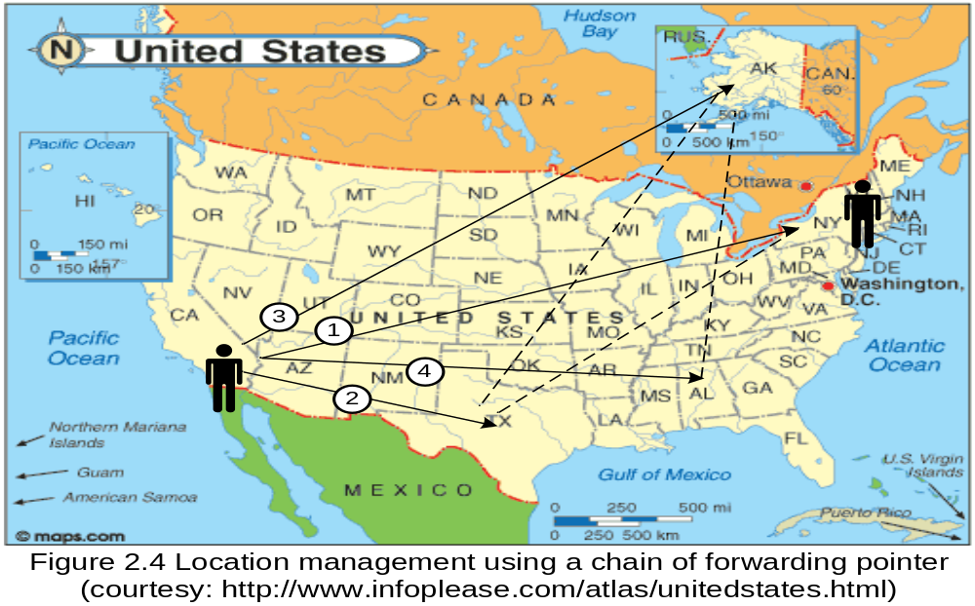
A Chain of Forwarding Pointers (cont.)

Slide 29
Static vs Dynamic Update Schemes
Static Update Scheme
  RA-based Location Update
  Ignore dynamic behavior of mobile nodes
  Boundaries of RAs are predetermined (static)
  Cost: a lot of location update due to mobile nodes moving between two adjacent RAs in quick succession
Dynamic Update Schemes
  Time-based (periodic) Updates
  Movement-based Updates
  Distance-based Updates

Slide 30
Dynamic Update Schemes
Time-based (periodic) Updates
  Update Control Timer
  The simplest method to implement
  Not suitable for stationary users

Slide 31
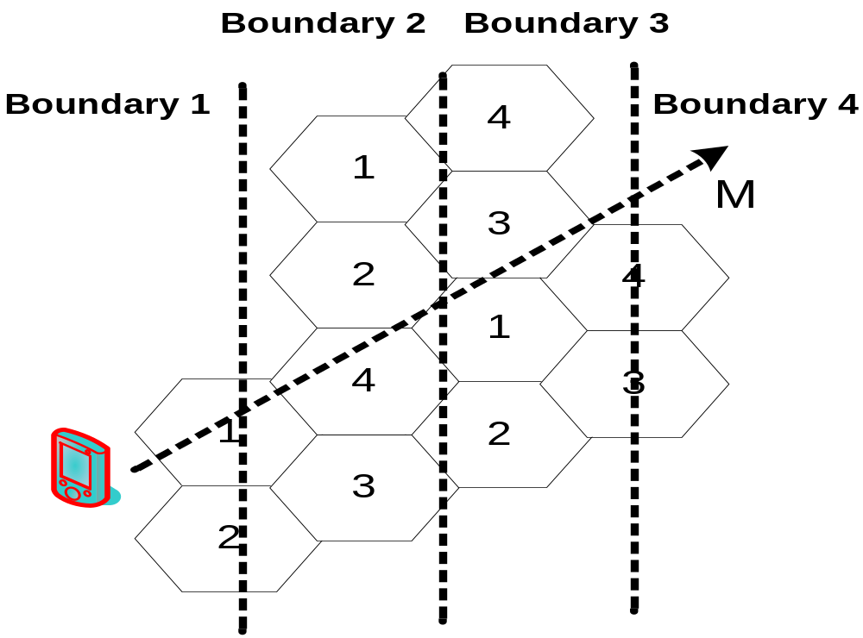
Dynamic Update Schemes
Movement-based Updates
  A mobile node update its location
  When?
    It crosses a certain number of cell boundaries M since it last registered
  Mechanism
    Counting the number of Handoffs since the last update
  Suitable for stationary users

Slide 32
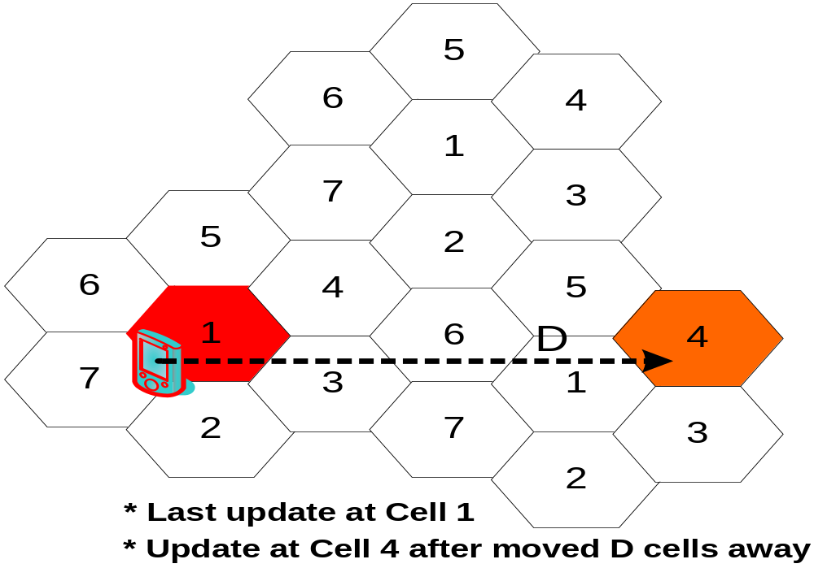
Dynamic Update Schemes
Distance-based Updates
  A mobile node updates its location
  When?
    It moves a certain number of cells D away from the last cell at which it last updated its location
  Need to know the topology of cellular network
  Difficult to implement
  Suitable for mobile user who moves within a locality

Slide 33
Location Management Case Studies
PCS location management scheme
Two types of location registrars are used: home location registrars (HLRs) and visitor location registrars (VLRs). The HLR keeps the location and profile information for all the mobile nodes to which the PCS network is supposed to provide service.
Each RA has a VLR associated with it that records the location (cell ID) of all the mobile nodes that currently are in that RA.
The HLR for a mobile node records the RA, which is the ID of the VLR associated with the RA in which the mobile node currently is located.
When a call needs to be established to mobile node m that is currently located in cell c of RAc, first the HLR of mobile node m[HLR(m)] is consulted to obtain the ID of the VLR [VLR(n)] that may have information about m; next, VLR(m) is contacted to obtain the current cell in which mobile node m is located. When a mobile node is switched on, it registers with one of the available access points (base stations).
This registration operation also involves updating the VLR and the HLR. While the mobile node remains active, a re-registration is performed (1) when a handoff occurs and (2) periodically.

Slide 34
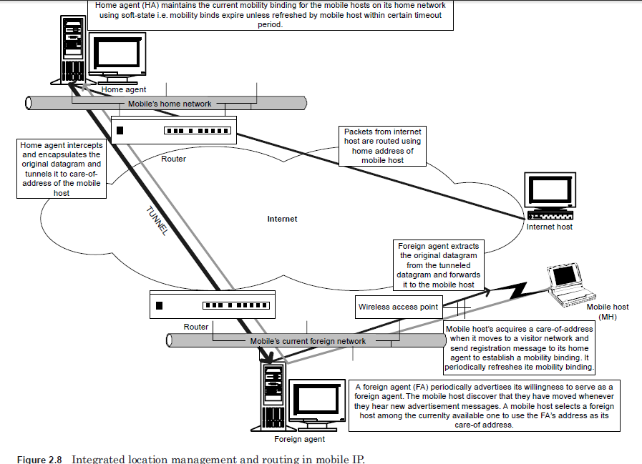

Slide 35
When a mobile node m moves from cell c to cell d, the following two scenarios are possible:
Both cells c and d belong to the same RA.
In this case, only the VLR is updated to indicate in which cell mobile node m is currently located.
This helps when mobile node m needs to be located. In this case, there is no need to contact the HLR(m).
Cells c and d belong to different registration areas, RAc and RAd , respectively. In this case, the following two actions need to be taken:
Mobile mode m needs to register with RAd and deregister with RAc.
HLR(m) needs to be notified that mobile node m is now in RAd.

Slide 36
Now let’s examine in more detail what actions need to be performed when mobile node m needs to be located, for example, to establish a connection between mobile nodes n and m.
Assume that mobile node n is in cell c and that mobile node m is in cell d, where cell c belongs to RAc and cell d belongs to RAd.
  First, VLR(RAd) is consulted to see whether mobile node m is in RAd. If so, a search is performed in the vicinity of last reported cell of mobile node m.
  If m is not RAd, then the HLR(m) is contacted to get the current RAm.
  VLR(RAm) is contacted and performs a local search in the last reported cell of mobile node m, and if successful, it returns the current location of mobile node m.

Slide 37
Mobile IP

